Slide 1

Loading

Slide 2

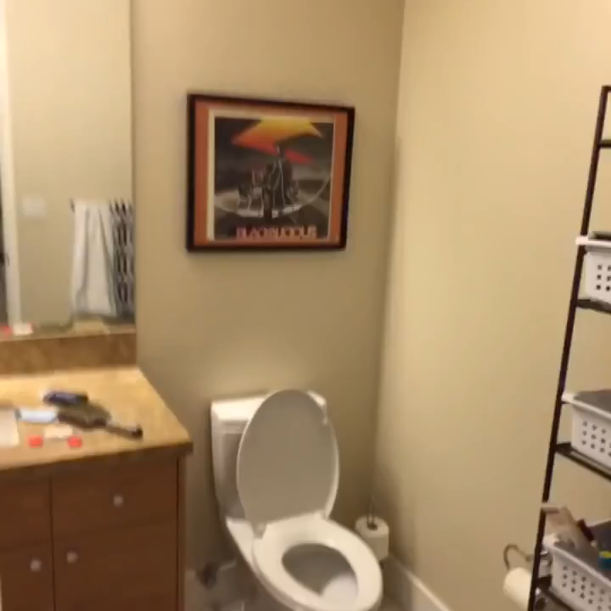

Slide 3
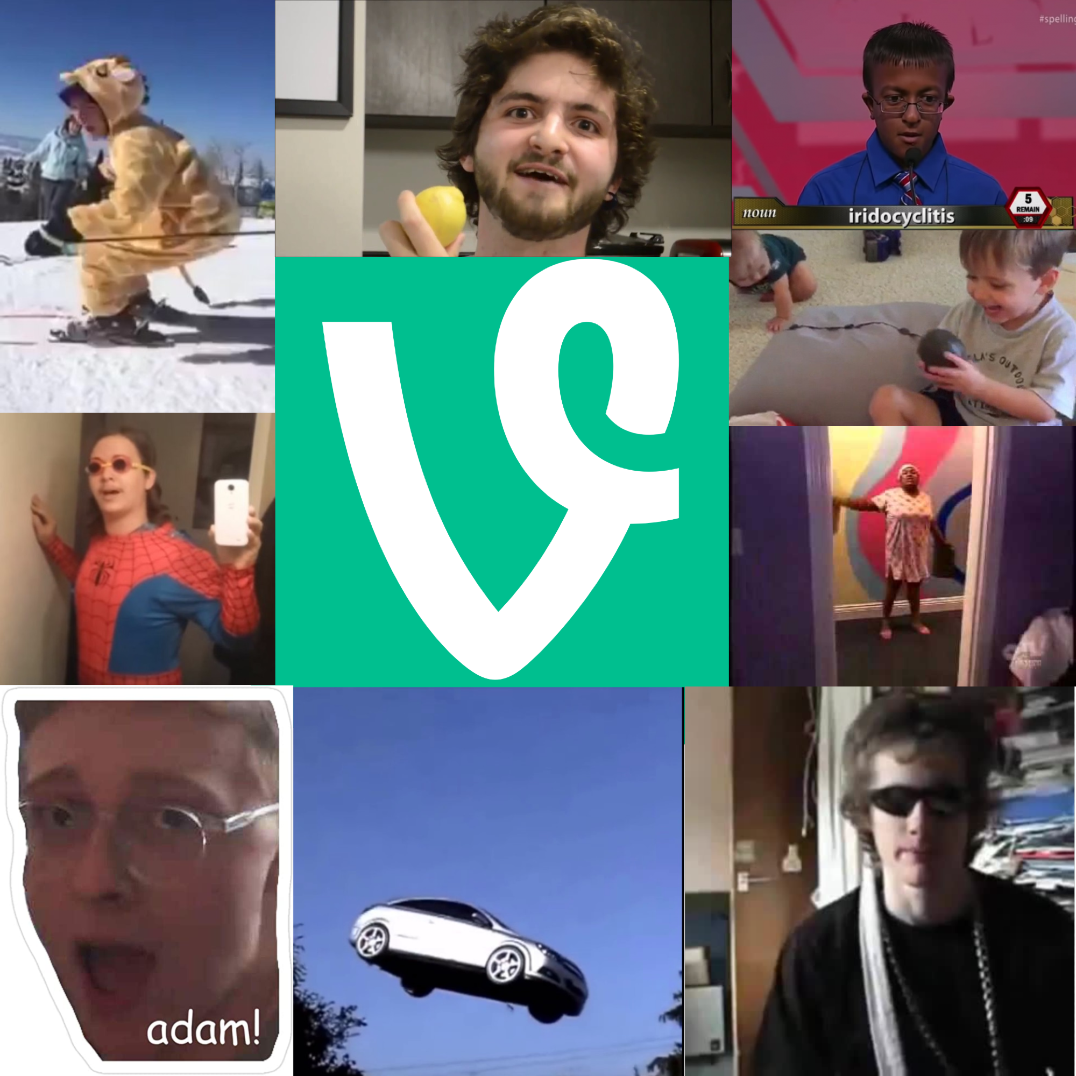
Vinescript
A statically typed language that
sports great functionality and a
large dose of nostalgia too.
Parker Bath, Amaya Alviz, Tyler Ilunga, Brandon Holmes, Seth Cassellius

Slide 4
What is Vine?
Well, if you’ve been living under a rock, it’s the OG version of TikTok and is better in every way.
Imagine making a TikTokscript…. Yeah, never mind, don’t hurt your brain like that.

Slide 5
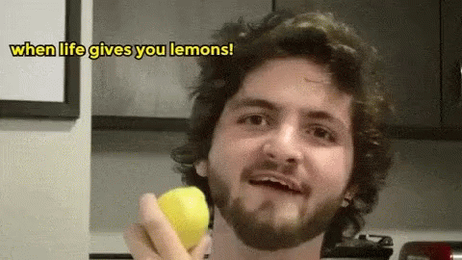


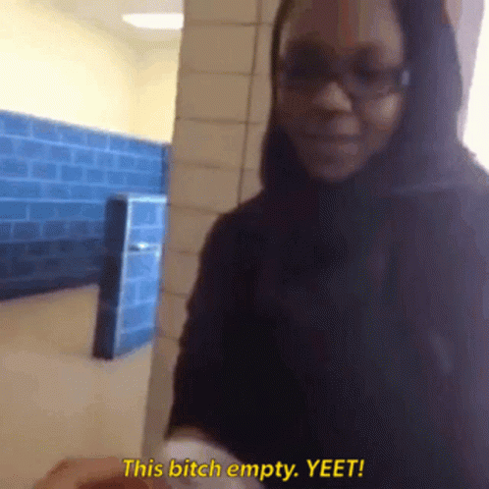


lookAtThisGraph
bitchIHopeTheFuckYouDo
orWhat
whenLifeGivesYouLemons
iAintNevaGunnaStopLuvinYouBiiitch
yeet
thisBitchEmpty
iSureHopeItDoes
thatIsNotCorrect
youreNotMyDad
let
if
else
function
while
break
return
true
false
negation

Slide 6
whenLifeGivesYouLemons int fibonacci(int n) {
bitchIHopeTheFuckYouDo(n == 0)
thisBitchEmpty 0
orWhat
lookAtThisGraph x = 0
lookAtThisGraph y = 1
lookAtThisGraph i = 1
iAintNevaGunnaStopLuvinYouBiiitch(i < n) {
lookAtThisGraph z = x + y
x = y
y = z
}
thisBitchEmpty y
}
lookAtThisGraph times = 10
fibonacci(times)

Slide 7
Challenges
There are far too many prime Vines to encapsulate in one coding language, and even harder to have them make sense as keywords.
“To dumb it down, I think that there were things we needed to fix that we didn’t realize were broken until we got to the analyzer. So, it’s safe to say our analyzer was a bitch and a half.” – Parker Bath
“It was difficult to keep working when we were all in Zoom and the VS Code live share and I kept hearing vine compilations coming from Parker because he was our dedicated research specialist, and I wanted to watch the vines too ☹” – Seth Cassellius
Vinescript is incredibly hard to read & write. It’s even harder to not laugh while reading it.

Slide 8


Lessons
When you get frustrated, with compliers or just with life, go watch some Vine Compilations.
Toal’s notes are god tier. Like, other schools use his notes?!?! It’s honestly depressing when you’re trying to study for any class outside of CS. I’ve actually been stuck in other classes and had to google something complex and frustrating, and Toal’s notes are the #1 result.
How to use VS Code live share to collaborate with my team effectively over a distance.
Analyzer:
Parker:

Slide 9
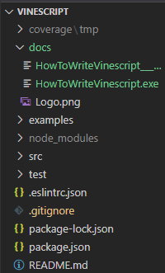
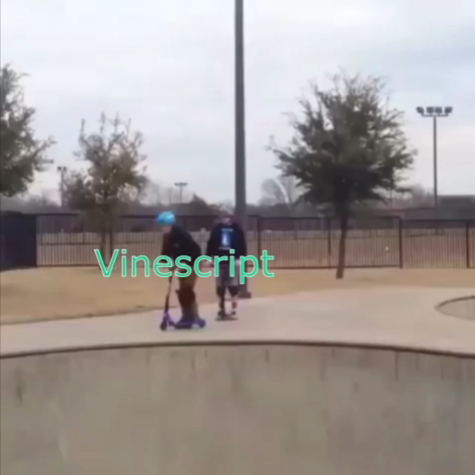
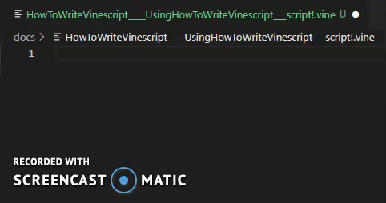
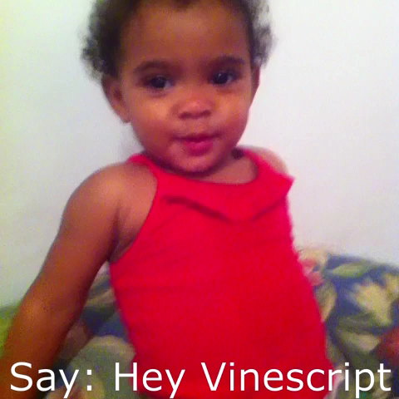
Thank you!

